Slide 1





Slide 2
“FLIGHT PRICE PREDICTION”
Submitted by:
RAHUL AHUJA

Slide 3
INTRODUCTION
Business Problem
Nowadays, the number of people using flights has increased significantly.
It is difficult for airlines to maintain prices since prices change dynamically due to different conditions. That’s why we will try to use machine learning to solve this problem.
This can help airlines by predicting what prices they can maintain. It can also help customers to predict future flight prices and plan their journey accordingly.
Anyone who has booked a flight ticket knows how unexpectedly the prices vary. The cheapest available ticket on a given flight gets more and less expensive over time. This usually happens as an attempt to maximize revenue based on –
1. Time of purchase patterns (making sure last-minute purchases are expensive)
2. Keeping the flight as full as they want it (raising prices on a flight which is filling up in order to reduce sales and hold back inventory for those expensive last-minute expensive purchases)

Slide 4
Motivation for the Problem Undertaken
The Motive behind doing this study and analysis is:
To build a model using Machine Learning in order to predict the fares of the flights.
To understand the purchase pattern of the flights.
To find out the variables are important to predict the price of flights.
To understand how do these variables describe the price of the flights.

Slide 5
Data Sources and their formats
The data has been scraped from the two websites from Makemytrip.com and Yatra.com. The Data has been gathered keeping base from Mumbai and Delhi
Data contains 3010 entries each having 9 variables.
Data contains no Null values.
Data contains numerical as well as categorical variable.

Slide 7
Data Pre-processing Done
Below are the steps taking for pre-processing and cleaning the data for the analysis.
The data has been scraped from MAKEMYTRIP.COM & YATRA.COM and downloaded data has been compiled in excel sheet in .CSV format.
The data is on both object and the integer/float format
The train data has total 3090 rows and 9 columns.
There are no null values in data.
Most of the data/columns are object type so we have to convert them into the integer format.
There is some skewness in data which is removed in processing model
The outliers are available in the data in Price and Duration column which has been removed before processing the Model.
Rectified the string data for visualization.
Used Label Encoder for converting the object data into Integer for further analysis.

Slide 8
Data Inputs- Logic- Output Relationships
The data has been categorized into two and that has been given x and y.
y data contains the columns (Fare Price of the flight).
x data contains the complete data which includes Airline Name, Departure time, arrival time, source and destination locations, duration of the flight, total stops in the flight and date of the journey.

Slide 9
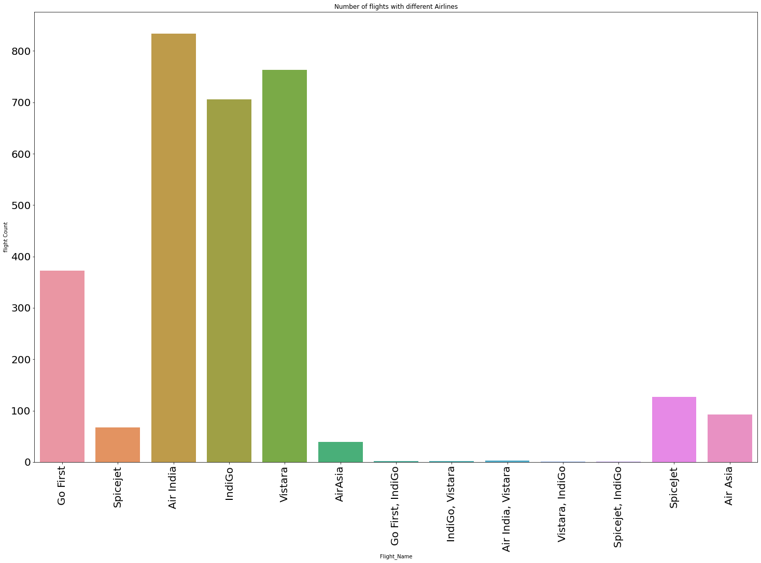
Model/s Development and Evaluation
Identification of possible problem-solving approaches (methods) Visualizations

Slide 10
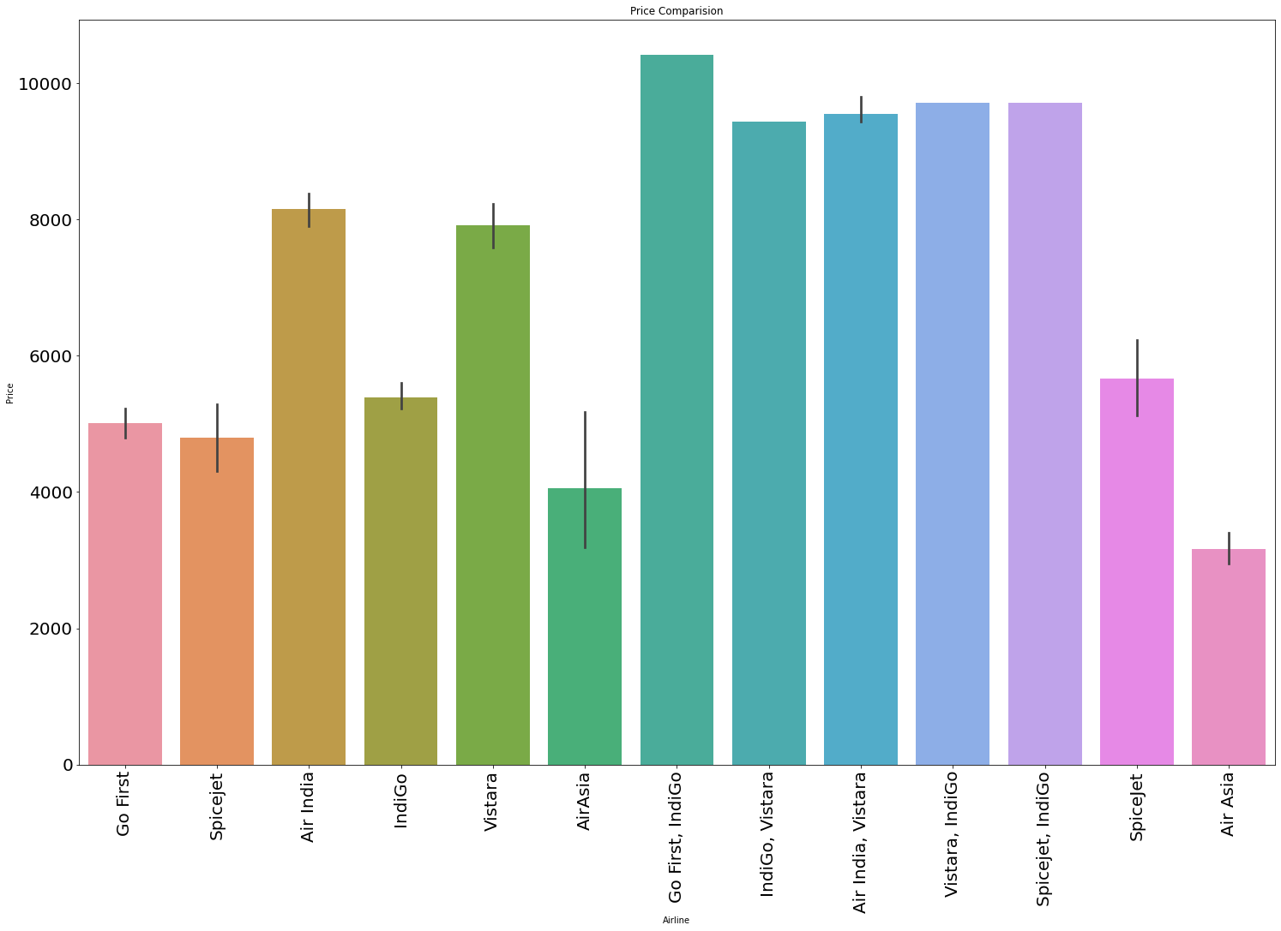

Slide 11
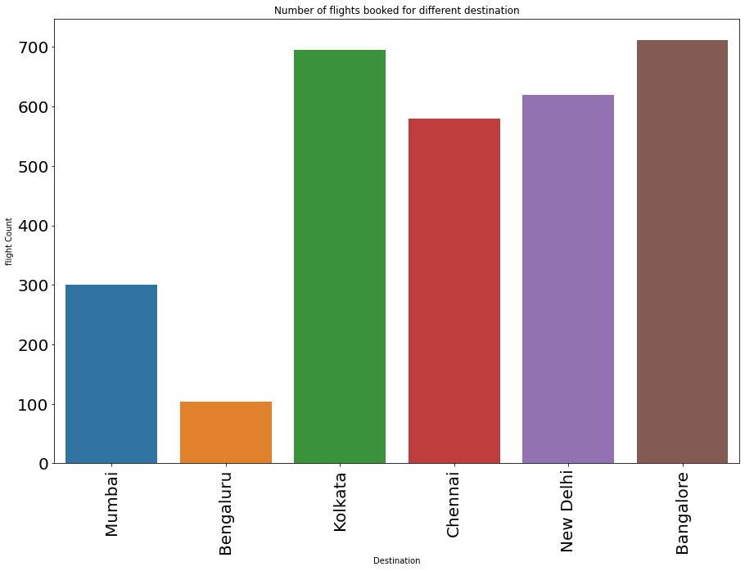

Slide 12
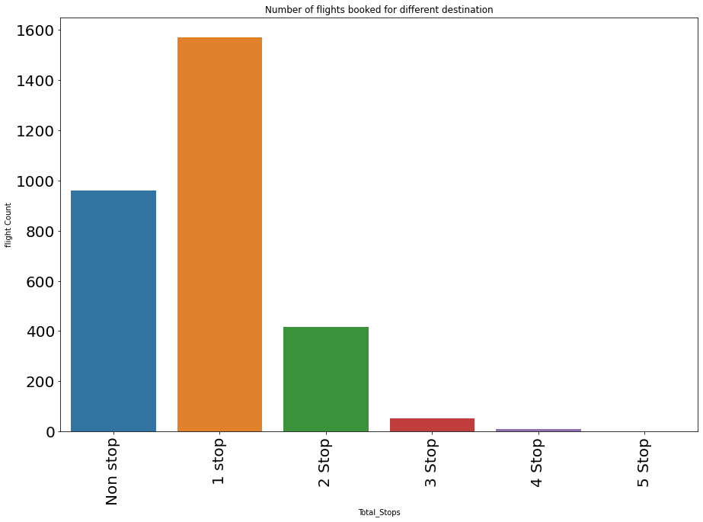

Slide 13
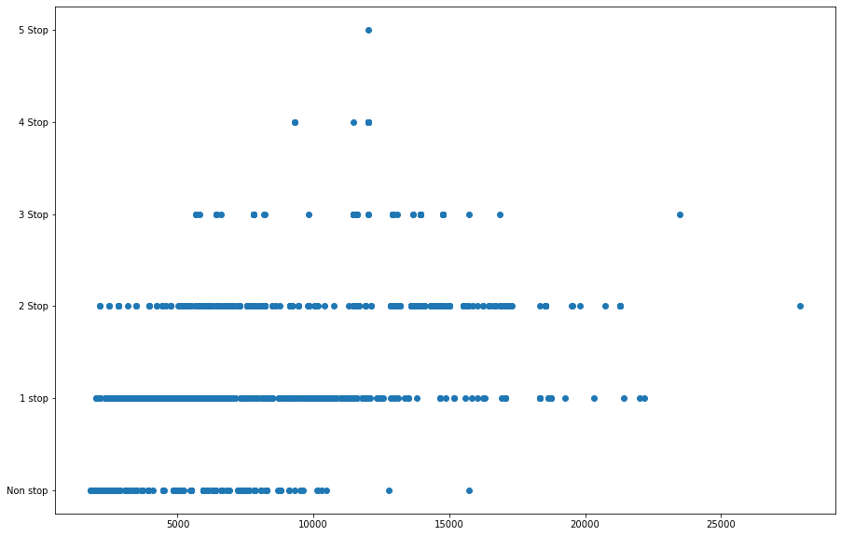

Slide 14
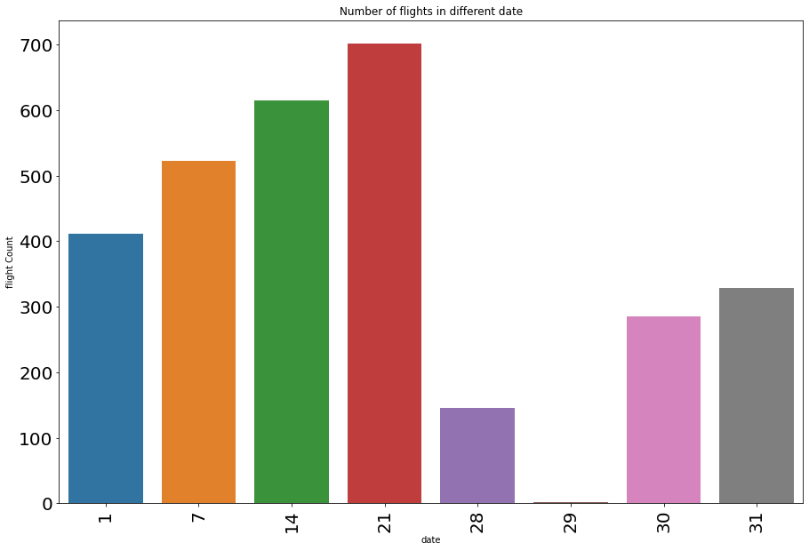

Slide 15
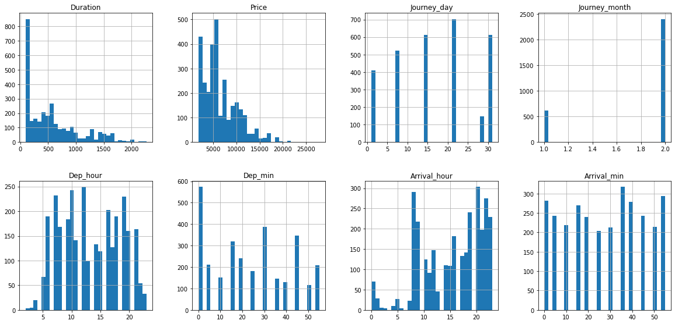

Slide 16
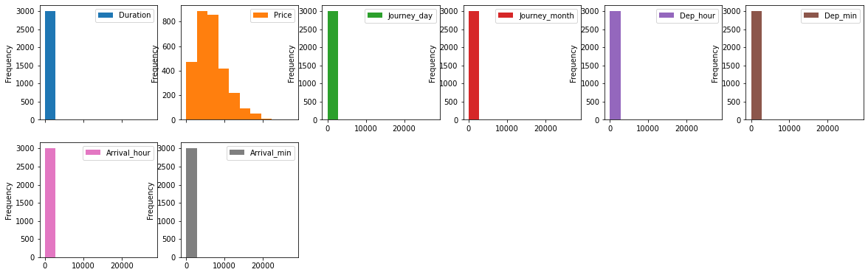

Slide 17
Key Findings of the study
Air-india is the popular airlines among all other. Vistara is the 2nd most popular one.
Bangalore and Delhi is the preferred location.
Airline companies preferred to make 1 stop flights as it helps to go economical.
The prices got increase with the stoppage increase.
As we increases the range of dates the prices starts decreasing. So it has a negative correlation.

Slide 18
Conclusions of the Study
After refining the data we have tested different models like Linear Regression, SVR, Decision Tree Regressor, K Neighbors Regressor, Random Forest Regressor, Ada Boost Regressor and the Gradient Boosting Regressor. After checking all this we have found that the Random Forest Regressor has provided the best result. The score of the same is mention below.

Slide 21
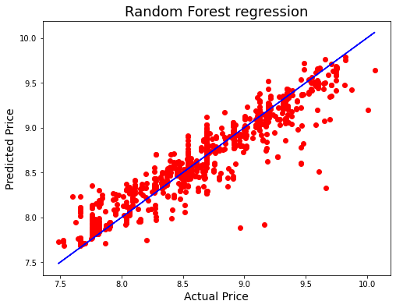
Below is the actual data v/s prediction data

Slide 22


